Slide 1
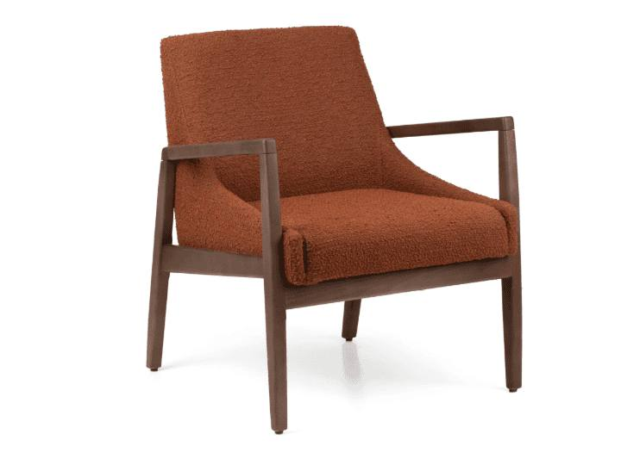
● COMMERCIAL CONTRACT FURNITURE
KECA U.S.A.
Indoor & Wood Collection
Solid-wood seating and tables built to order by the KECA International wood workshop — plus contract-grade upholstered seating for hospitality, workplace and senior living.
kecausa.com · 305-833-0896 · Fort Lauderdale, Florida

Slide 2
● WHY KECA
One partner for the whole interior
1
2
3
Solid-Wood Workshop
Upholstered Contract Seating
A Program Built for Designers
A full indoor line — dining chairs, barstools, lounge seating and tables — built to order in solid wood by the KECA International wood workshop and stain-matched to your project.
Contract-grade upholstered and office seating from our Tilia indoor program: armchairs, side chairs, bar chairs and waiting-area seating with wide fabric color programs.
Custom stains and fabrics, COM options on select collections, custom sizes on select tables and lounge pieces — and volume quotes within one business day.
KECA U.S.A. · kecausa.com
2

Slide 3
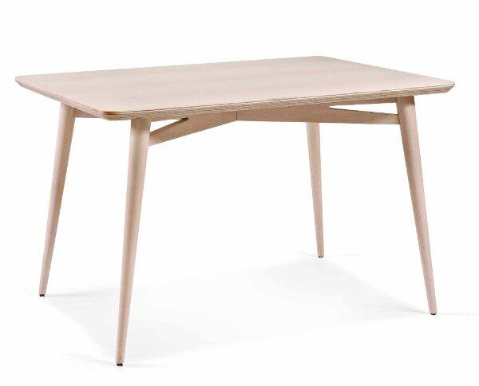
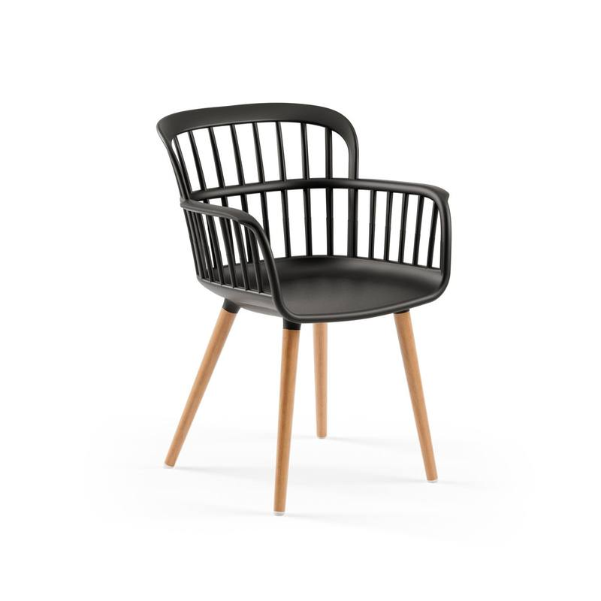
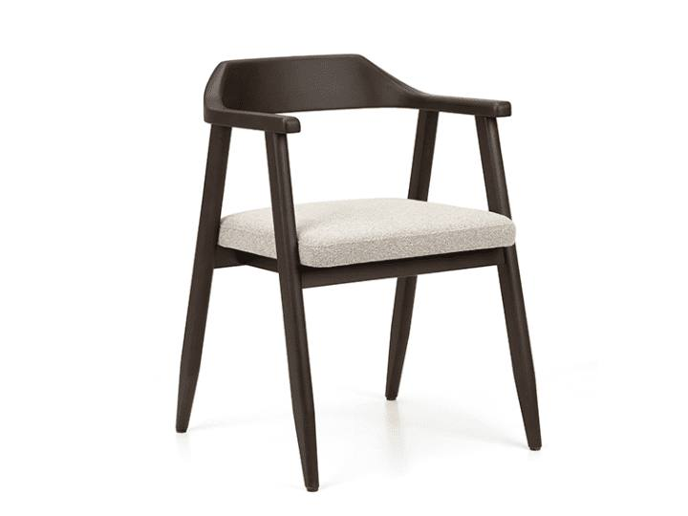
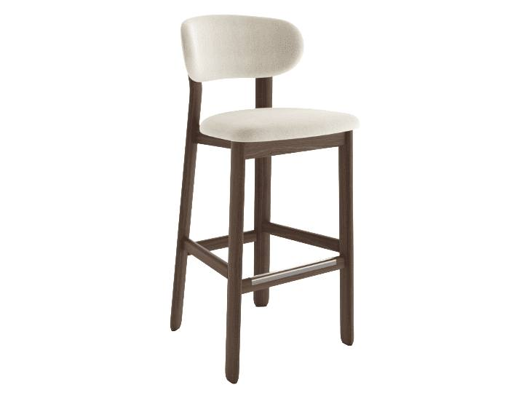
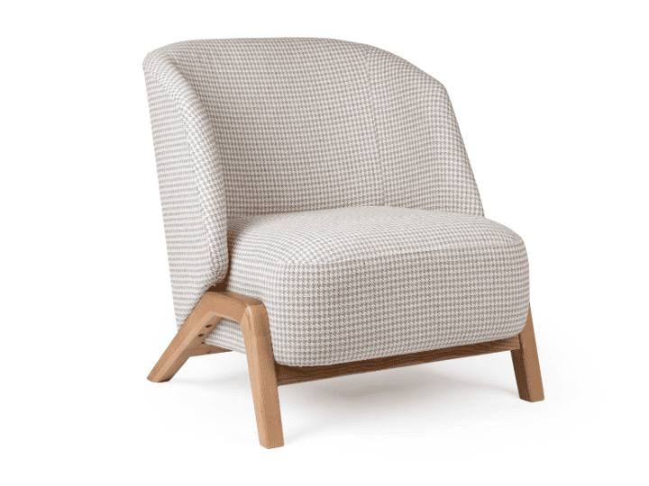
● THE RANGE
The indoor range at a glance
35
35
35
34
69
WOOD CHAIRS
WOOD BARSTOOLS
LOUNGE SEATING
INDOOR TABLES
UPHOLSTERED & OFFICE
Solid wood · made to order
Solid wood · made to order
Solid wood · made to order
Custom sizes · made to order
Tilia indoor · ≈8-week lead
139 solid-wood designs made to order by the KECA International wood workshop · Tilia seating on an approx. 8-week lead, select models stocked in Florida
KECA U.S.A. · kecausa.com
3

Slide 4
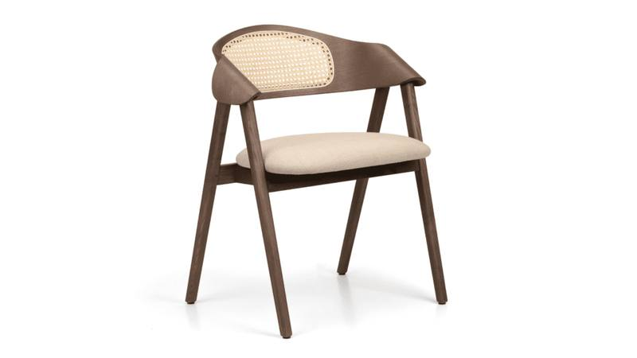
● WOOD CHAIRS — MADE TO ORDER
Wicker-Back Dining Armchair
SKU BW-DINAARM-USW
Solid wood frame with a sculptural curved backrest
Woven wicker back panel with upholstered seat
Customizable stain finish and seat fabric
DIMENSIONS & OPTIONS
25.26" W · 20.75" D · 30.25" H · seat 19"
KECA U.S.A. · kecausa.com
4

Slide 5
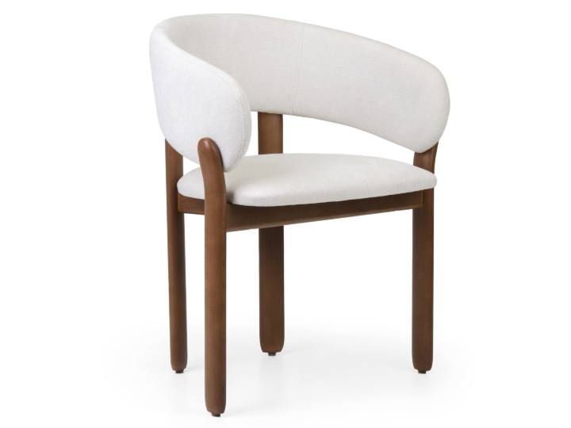
● WOOD CHAIRS — MADE TO ORDER
Bao Dining Armchair
SKU BW-BAOARM-USB
Rounded backrest, upholstered seat and back
Solid wood frame in a dark walnut finish
Compact footprint for dining rooms and restaurants
DIMENSIONS & OPTIONS
24.75" W · 22.05" D · 31.5" H · seat 19.75"
KECA U.S.A. · kecausa.com
5

Slide 6
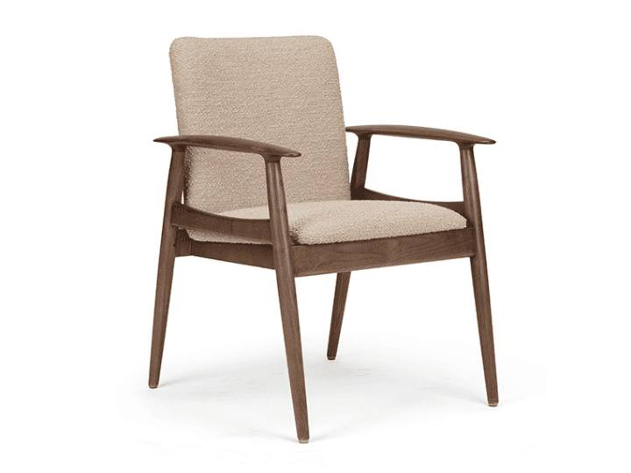
● WOOD CHAIRS — MADE TO ORDER
Sandy Mid-Century Armchair
SKU BW-SANDYARM-ARM
Walnut-finish frame, open paddle arms, tapered legs
Designed for hospitality and senior living
Two back heights: Standard and High-Back
Custom stains and fabrics, incl. COM and antimicrobial
DIMENSIONS & OPTIONS
24.75" W · 27.25" D · 34.75" H · seat 19.25"
KECA U.S.A. · kecausa.com
6

Slide 7
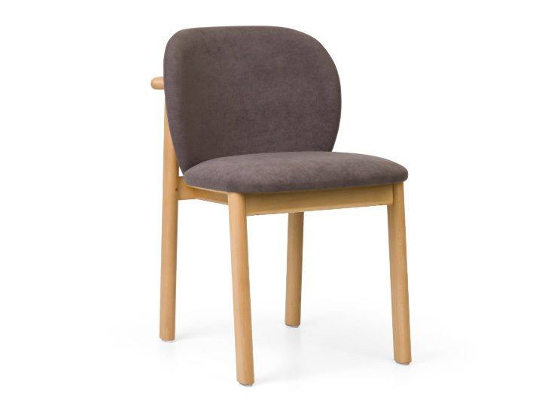
● WOOD CHAIRS — MADE TO ORDER
Elle Upholstered Dining Chair
SKU BW-ELLE-USB
Fully upholstered rounded back and seat
Cocooning silhouette on a solid wood frame
Customizable stain finish and fabric
DIMENSIONS & OPTIONS
18.5" W · 22" D · 30.25" H · seat 19.25"
KECA U.S.A. · kecausa.com
7

Slide 8
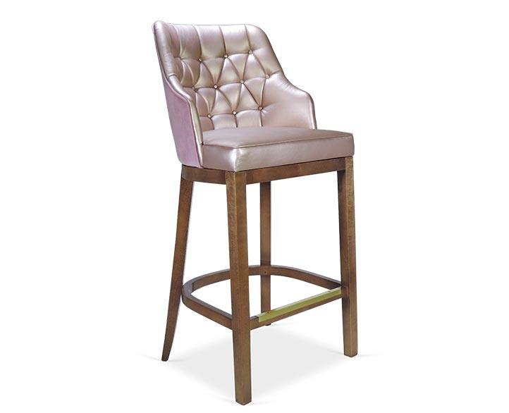
● WOOD BARSTOOLS — MADE TO ORDER
Diamond-Tufted Barstool
SKU CG-RUTHS
Diamond-upholstered seat and back
Brass nailhead detailing
Solid wood frame, built to order in custom finishes
DIMENSIONS & OPTIONS
23" D · 47" H · seat 30"
KECA U.S.A. · kecausa.com
8

Slide 9
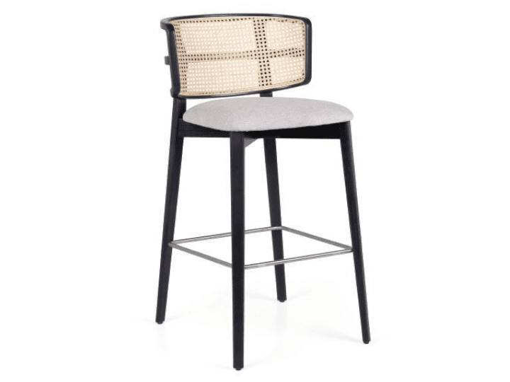
● WOOD BARSTOOLS — MADE TO ORDER
Tennis Caned-Back Barstool
SKU BW-TENNISBAR-USW
Optional caned wicker backrest for an airy profile
Solid wood frame with upholstered seat
Custom stain finish and seat fabric
DIMENSIONS & OPTIONS
24" D · seat 31"
KECA U.S.A. · kecausa.com
9

Slide 10
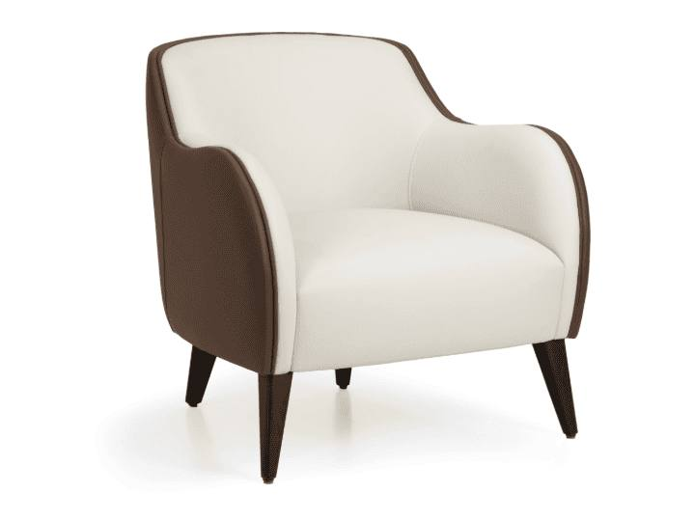
● LOUNGE SEATING — MADE TO ORDER
Gina Lounge Chair
SKU CG-GINA
Bi-colour shell: plush interior, contrast exterior
Sculpted barrel back with flared armrests
Tapered dark walnut legs; custom sizes available
DIMENSIONS & OPTIONS
30" W · 31.5" D · 30.75" H · seat 17.25"
KECA U.S.A. · kecausa.com
10

Slide 11
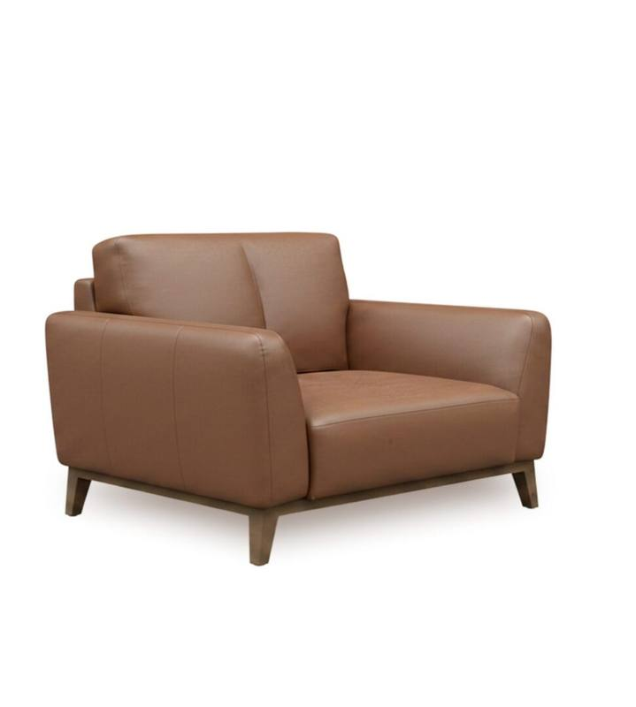
● LOUNGE SEATING — MADE TO ORDER
Luna Sofa Collection
SKU CG-LUNA
Channel-tufted back, premium leather upholstery
Solid walnut-finish tapered legs
1-, 2- and 3-seater configurations
Custom upholstery and finish options
DIMENSIONS & OPTIONS
Custom sizes available
KECA U.S.A. · kecausa.com
11

Slide 12
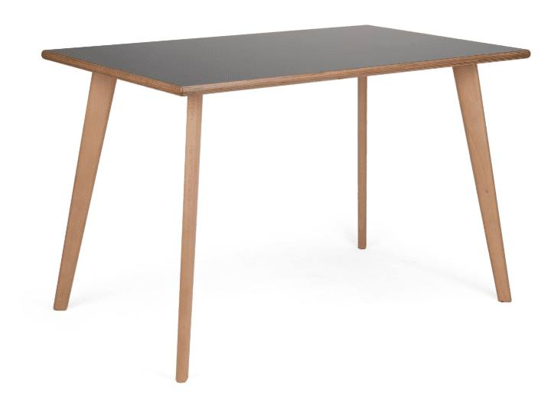
● INDOOR TABLES — MADE TO ORDER
Gigi Dining Table
SKU TC-GIGI
Solid wood frame, veneered top, chamfered edge
Round, square and rectangular formats
Wide range of custom stain finishes
Sizes from 30" x 30" to 40" x 96"; custom on request
DIMENSIONS & OPTIONS
Popular rounds: 42" · 48" · 54" · 60" dia.
KECA U.S.A. · kecausa.com
12

Slide 13
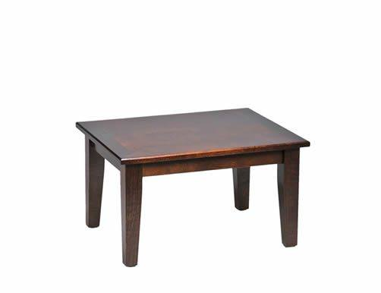
● INDOOR TABLES — MADE TO ORDER
TA-6000 Table Collection
SKU TA-6000
One collection — coffee tables to bar tops
Round or square, custom sized, stain matched
Tops in laminate or wood with wood edge
DIMENSIONS & OPTIONS
Custom sizes available
KECA U.S.A. · kecausa.com
13

Slide 14
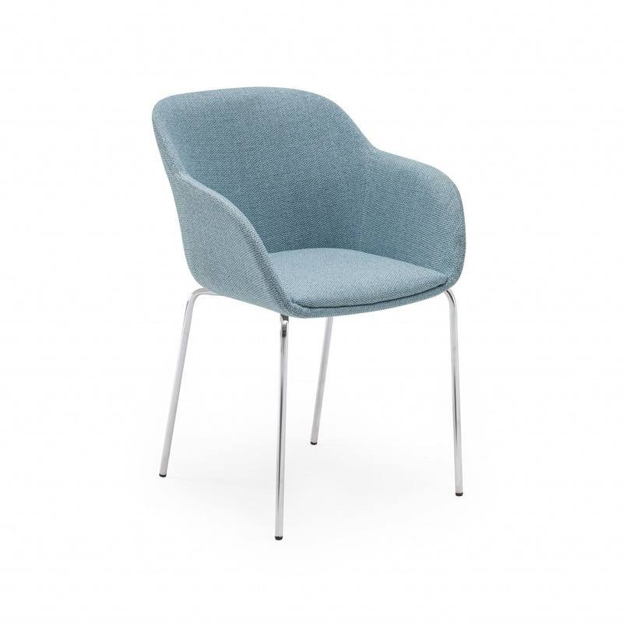
● UPHOLSTERED SEATING — TILIA INDOOR
Shell-M Upholstered Armchair
TILIA INDOOR PROGRAM
Chromed frame with fully upholstered shell
14 fabric colorways, including knits
Easy-clean contract seating with armrests
Typically ships on an approx. 8-week lead
DIMENSIONS & OPTIONS
Made to order
KECA U.S.A. · kecausa.com
14

Slide 15
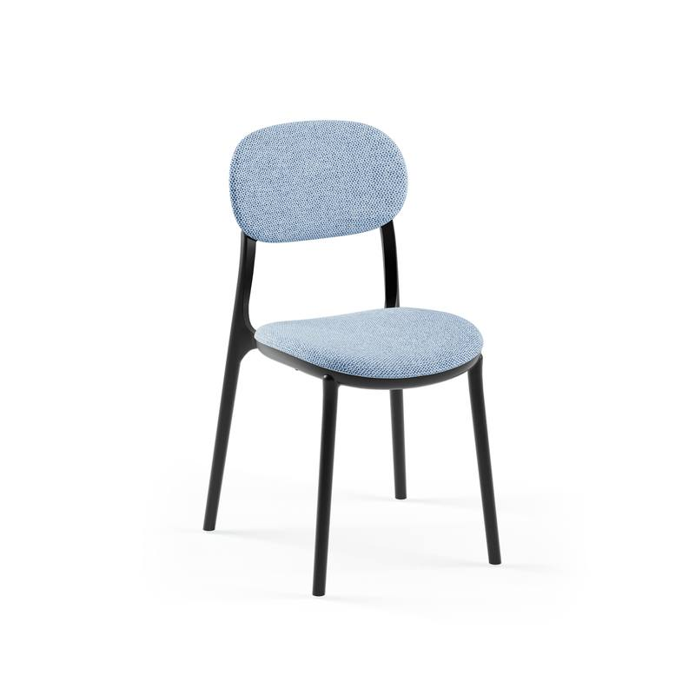
● UPHOLSTERED SEATING — TILIA INDOOR
Duo Upholstered Chair
TILIA INDOOR PROGRAM
100% recyclable glass-reinforced polypropylene
Upholstered seat pad; 20 color and fabric options
Multi-piece, interchangeable construction
Typically ships on an approx. 8-week lead
DIMENSIONS & OPTIONS
Easy to clean · suitable for indoor use
KECA U.S.A. · kecausa.com
15

Slide 16
● MADE TO ORDER
Made to order, made yours
Frames & Finishes
Upholstery & Fabrics
Built to order by the KECA International wood workshop
Custom stain program — stain-matched across collections
Walnut and natural finishes; wicker and caned-back details
Custom dimensions on select tables and lounge collections
Upholstered seat, seat + back, or wood-seat configurations
Fabric program with COM and antimicrobial options on select collections
Tilia color programs with up to 28 fabric and faux-leather options
Diamond-tufted and channel-stitched detailing on select designs
Wood line: made to order from the KECA International wood workshop. Tilia indoor seating: typically an approx. 8-week lead, with select models stocked in Florida.
KECA U.S.A. · kecausa.com
16

Slide 17
● START A QUOTE
Let's spec your project
KECA U.S.A. — Commercial Contract Furniture
kecausa.com · 305-833-0896 · Fort Lauderdale, Florida
Volume quotes within one business day
KECA U.S.A. · kecausa.com
17

