Slide 1
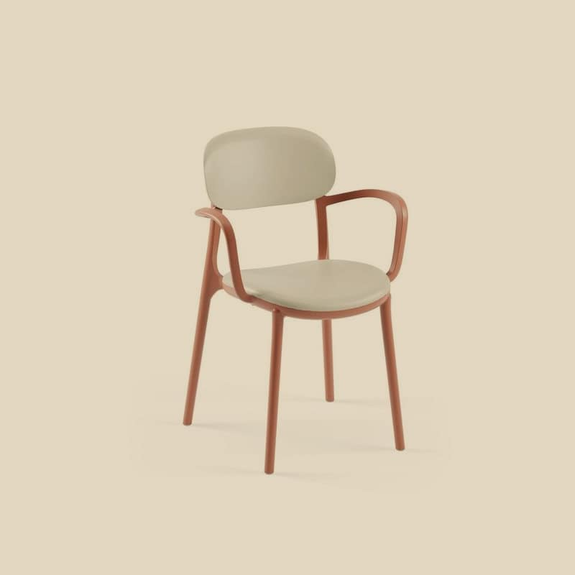
KECA U.S.A. · COMMERCIAL CONTRACT FURNITURE
Outdoor Contract
Collection
Contract-grade Tilia outdoor furniture for hotels, restaurants, and resort spaces — stocked and supported from Florida.
118 outdoor SKUs · 14 in Florida stock · volume quotes in one business day
ALI ARMCHAIR · TERRACOTTA · TILIA
kecausa.com · 305-833-0896 · Fort Lauderdale, Florida

Slide 2
WHY KECA
Built for purchasing teams
and project deadlines
01
02
03
04
Florida stock
Contract-grade manufacturing
Volume program
Quotes in one business day
In-stock lines ship from our Florida warehouse as soon as your order is confirmed — no import wait.
The full Tilia outdoor range: contract-grade, UV-stabilized furniture made for daily commercial use.
Project pricing that scales with quantity — for designers, hotels, restaurant groups, and resorts.
Send quantities and finishes — a complete volume quote comes back within one business day.
KECA U.S.A. — OUTDOOR CONTRACT COLLECTION
kecausa.com · 02

Slide 3
RANGE OVERVIEW
One range for the whole floor plan
118 outdoor SKUs — quote every category in a single program.
35
32
18
10
TABLES
CHAIRS
ARMCHAIRS
BARSTOOLS
8
4
3
8
BAR TABLES
LOUNGE SETS
SUNBEDS
COFFEE TABLES, BASES & CUSHIONS
KECA U.S.A. — OUTDOOR CONTRACT COLLECTION
kecausa.com · 03

Slide 4
OUTDOOR COLLECTION — ARMCHAIRS
Ali Armchair
Glass-reinforced PP — 100% recyclable
Stackable, with integrated armrests
Tone-on-tone interchangeable seat & body colors
Easy-clean, outdoor-rated finish
Available in 10 colors
+2
MADE TO ORDER — 8–12 WEEKS
TERRACOTTA · SHOWN
KECA U.S.A. — OUTDOOR CONTRACT COLLECTION
kecausa.com · 04

Slide 5
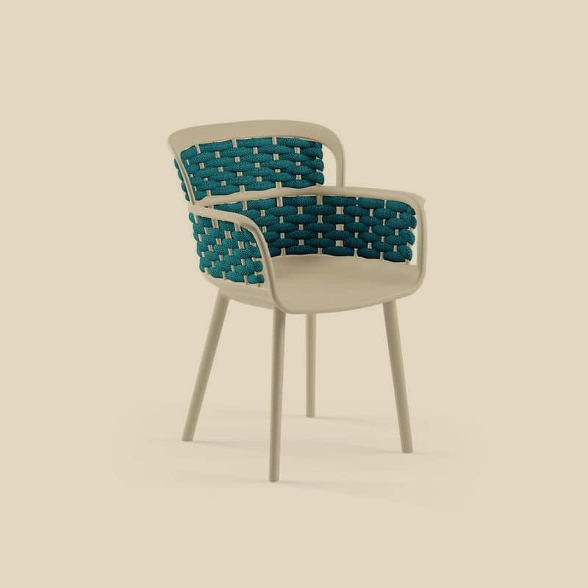
OUTDOOR COLLECTION — ARMCHAIRS
Eva-P Knitted Armchair
Knitted-texture shell in glass-reinforced PP
Open, breathing back with sculpted stripes
Integrated armrests, easy-clean finish
Rated for indoor and outdoor use
Available in 10 colors
+2
IN STOCK — SHIPS FROM FLORIDA
BLUE · SHOWN
KECA U.S.A. — OUTDOOR CONTRACT COLLECTION
kecausa.com · 05

Slide 6
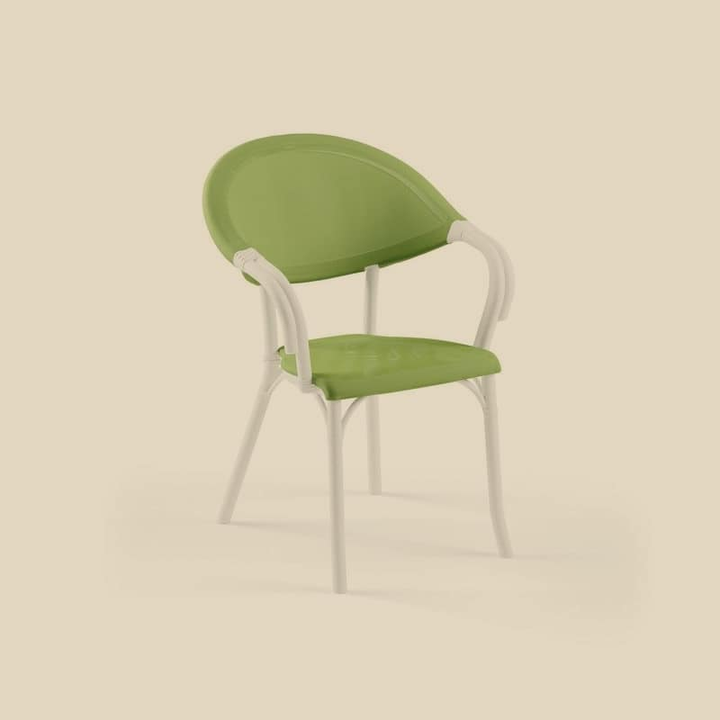
OUTDOOR COLLECTION — ARMCHAIRS
Flash-N Mesh Armchair
Twisted-frame body with textile mesh back
Dual-color PVC patterned mesh options
At home in gardens, balconies & poolside
Easy-clean, outdoor-rated build
Available in 18 colors
+10
IN STOCK — SHIPS FROM FLORIDA
GREEN · SHOWN
KECA U.S.A. — OUTDOOR CONTRACT COLLECTION
kecausa.com · 06

Slide 7
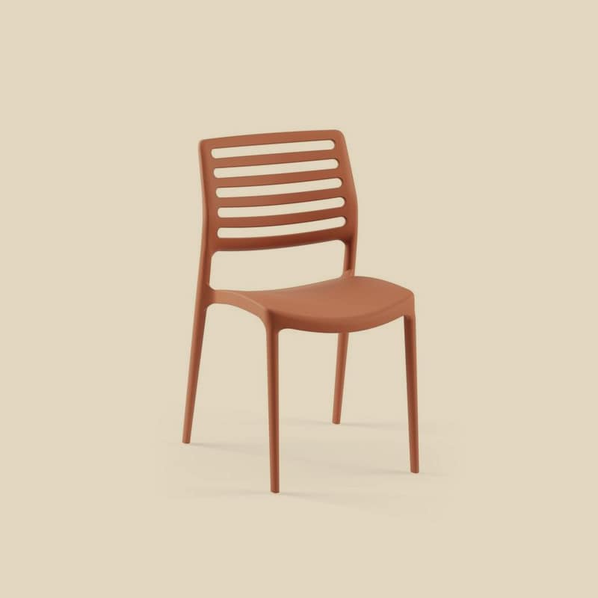
OUTDOOR COLLECTION — CHAIRS
Louise Chair
Tilia’s lightest chair — just 3.2 kg
Gas-injection, glass-fiber reinforced shell
Stacks up to 9 high for fast resets
Monoblock, easy-clean construction
Available in 10 colors
+2
IN STOCK — SHIPS FROM FLORIDA
TERRACOTTA · SHOWN
KECA U.S.A. — OUTDOOR CONTRACT COLLECTION
kecausa.com · 07

Slide 8
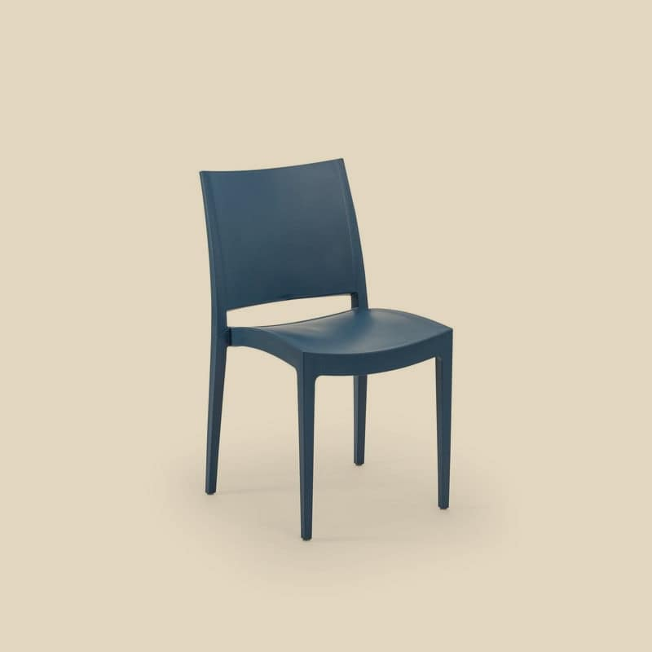
OUTDOOR COLLECTION — CHAIRS
Specto Stackable Chair
Gas-injection PP monoblock
Stackable — easy turnover and storage
Palette from red & orange to pistachio & royal blue
Outdoor-rated, easy to clean
Available in 9 colors
+1
IN STOCK — SHIPS FROM FLORIDA
SAX BLUE · SHOWN
KECA U.S.A. — OUTDOOR CONTRACT COLLECTION
kecausa.com · 08

Slide 9
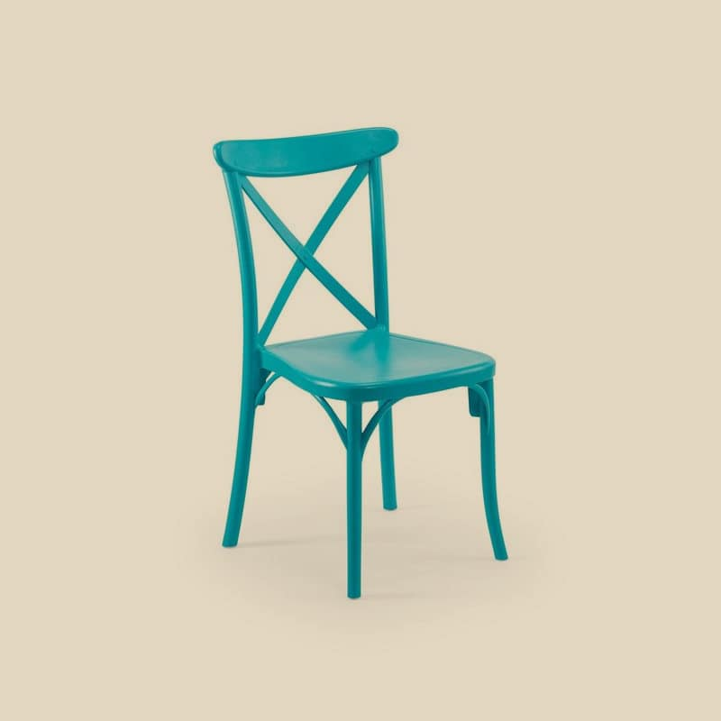
OUTDOOR COLLECTION — CHAIRS
Capri Stackable Chair
Signature X-back with wood-texture surface
Lightweight monoblock — indoor & outdoor
Replaceable anti-slip PVC floor plugs
Stackable, easy-clean construction
Available in 6 colors
IN STOCK — SHIPS FROM FLORIDA
TURQUOISE · SHOWN
KECA U.S.A. — OUTDOOR CONTRACT COLLECTION
kecausa.com · 09

Slide 10
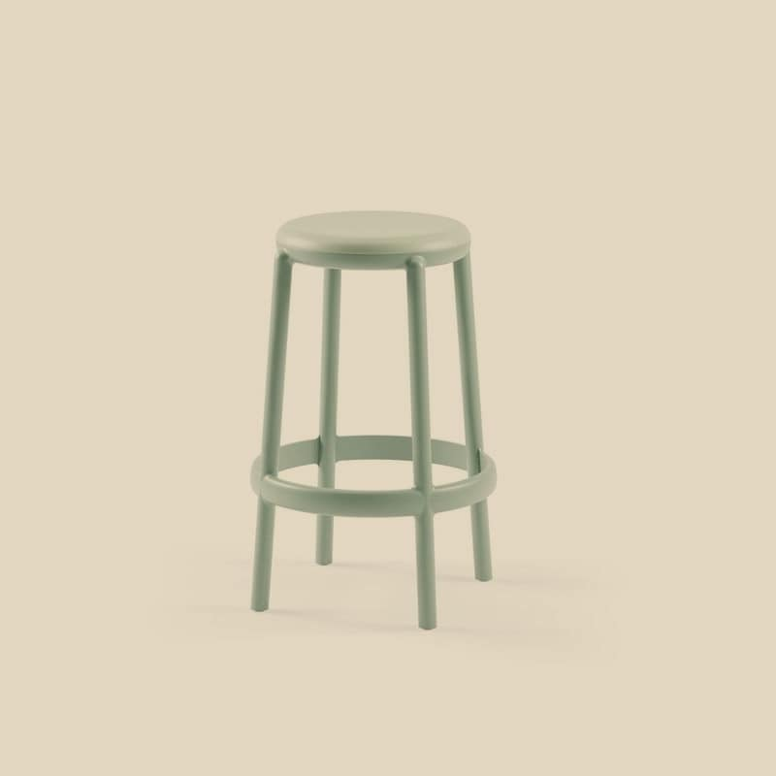
OUTDOOR COLLECTION — BARSTOOLS
Duo Bar Stool
Durable stackable plastic barstool
Two seat heights: 65 cm and 75 cm
Two-tone seat & body color program
Easy-clean, outdoor-rated finish
Available in 9 colors
+1
MADE TO ORDER — 8–12 WEEKS
NILE GREEN · SHOWN
KECA U.S.A. — OUTDOOR CONTRACT COLLECTION
kecausa.com · 10

Slide 11
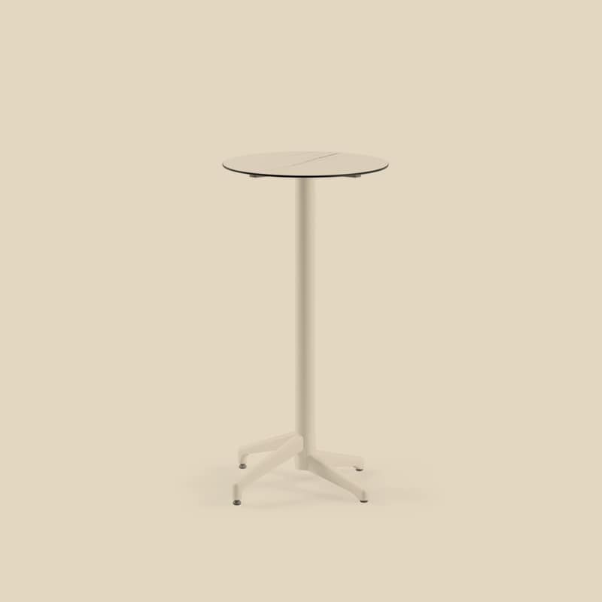
OUTDOOR COLLECTION — BAR TABLES
Moon-C Bar Table Ø60 cm
Built for changing outdoor weather
Easy-clean HPL/CPL tops — marble & terrazzo looks
Bar height: 111 cm
Also in Ø69 & Ø77, fixed or foldable
Available in 11 colors
+3
MADE TO ORDER — 8–12 WEEKS
HPL/CPL WHITE MARBLE · SHOWN
KECA U.S.A. — OUTDOOR CONTRACT COLLECTION
kecausa.com · 11

Slide 12
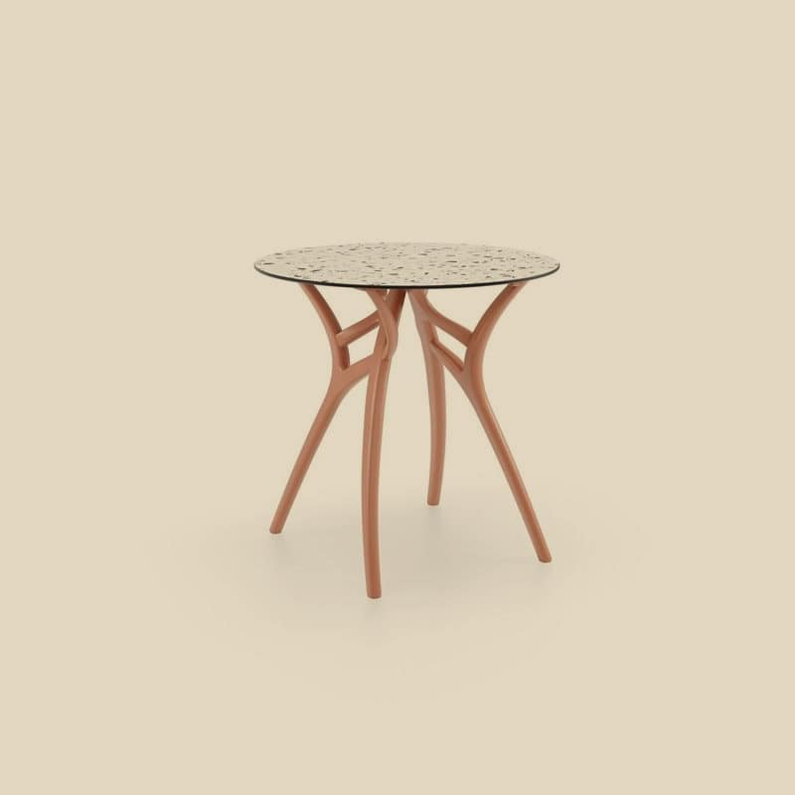
OUTDOOR COLLECTION — TABLES
Ivy-L Table Ø77 cm
Sculptural tree-inspired base by Kilittaşı Design
Round Ø77 cm top for intimate seating
Rated for indoor and outdoor use
Square & rectangular Ivy-L sizes in range
Available in 13 colors
+5
MADE TO ORDER — 8–12 WEEKS
TERRACOTTA · SHOWN
KECA U.S.A. — OUTDOOR CONTRACT COLLECTION
kecausa.com · 12

Slide 13
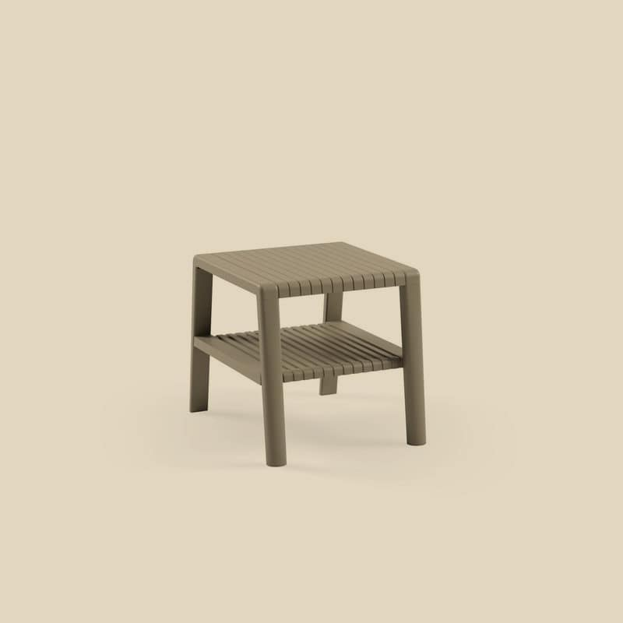
OUTDOOR COLLECTION — COFFEE TABLES
Joker Outdoor Coffee Table
Original design by Kunter Şekercioğlu
Tool-free assembly — four plastic screws
Just 2.3 kg — moves anywhere on the terrace
Stacks flat for storage
Available in 4 colors
IN STOCK — SHIPS FROM FLORIDA
MINK · SHOWN
KECA U.S.A. — OUTDOOR CONTRACT COLLECTION
kecausa.com · 13

Slide 14
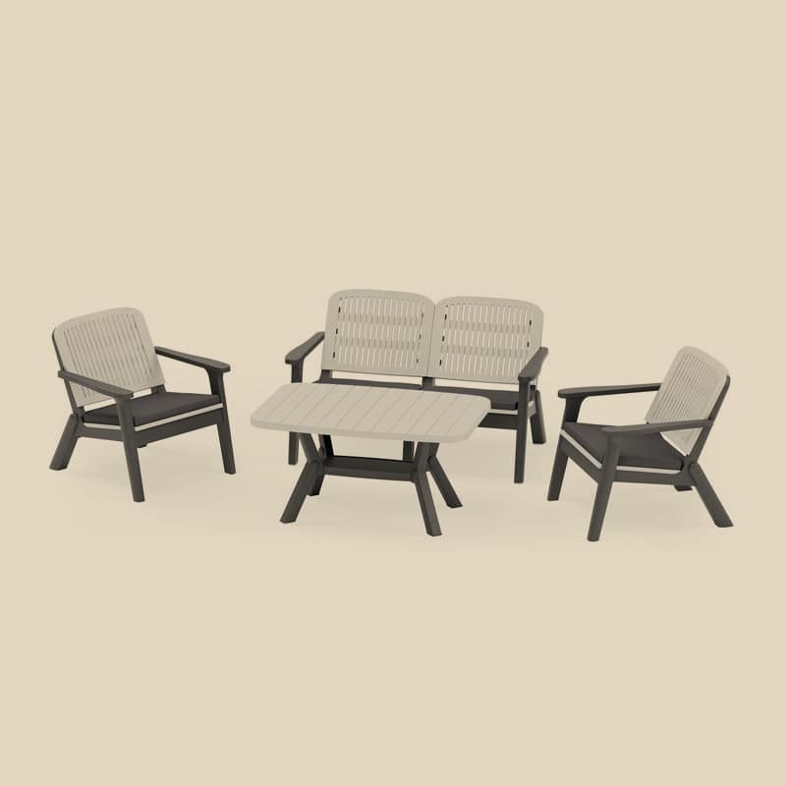
OUTDOOR COLLECTION — LOUNGE SETS
Silva II Lounge Set
Wood-texture frame with modern grid design
Deep comfort cushions for lounge seating
Sturdy, weather-resistant construction
Garden, terrace & veranda ready
Available in 4 colors
MADE TO ORDER — 8–12 WEEKS
ANTHRACITE · SHOWN
KECA U.S.A. — OUTDOOR CONTRACT COLLECTION
kecausa.com · 14

Slide 15
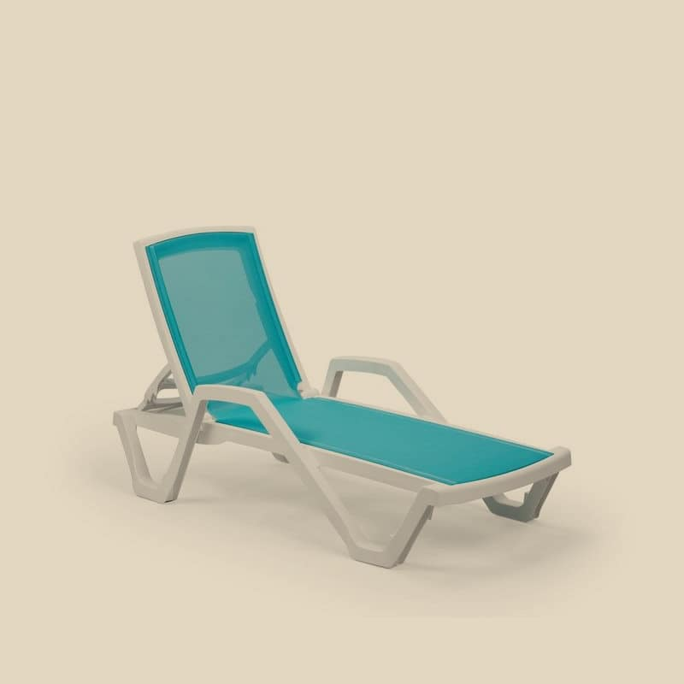
OUTDOOR COLLECTION — SUNBEDS
Mare Sunbed
100% pure PP frame + synthetic mesh sling
4-position adjustable backrest
Hidden wheels & non-slip feet
Stacks up to 25 units for storage
Available in 16 colors
+8
IN STOCK — SHIPS FROM FLORIDA
BLUE · SHOWN
KECA U.S.A. — OUTDOOR CONTRACT COLLECTION
kecausa.com · 15

Slide 16
AVAILABILITY
Stock & lead times
SHIPS NOW
MADE TO ORDER
In stock — Florida
Factory program
14 outdoor SKUs are on the ground in Florida right now — including best-selling stacking chairs, armchairs, and the Mare sunbed — and ship as soon as your order is confirmed.
The balance of the range is produced to order by Tilia in the colors and finishes you specify, typically landing in approximately 8–12 weeks. Ideal for larger rollouts planned a season ahead.
Mix in-stock and made-to-order lines on one quote. Volume quotes within one business day.
KECA U.S.A. — OUTDOOR CONTRACT COLLECTION
kecausa.com · 16

Slide 17
GET A QUOTE
Let’s spec your
outdoor project.
KECA U.S.A.
COMMERCIAL CONTRACT FURNITURE
kecausa.com
305-833-0896
Fort Lauderdale, Florida
Send your product list, quantities, and finishes — we’ll return a complete volume quote within one business day.
Volume quotes within one business day
KECA U.S.A. — Commercial Contract Furniture · kecausa.com · 305-833-0896 · Fort Lauderdale, Florida · Volume quotes within one business day

